Slide 1
Relational theory

Slide 2
Relational table (relation)
A relation is a set of elements called tuples.
Relation - A flat table consisting of columns and rows
Tuple - String of a relationship.
In mathematics, a tuple is a sequence of a finite number of elements.
Many mathematical objects are formally defined as tuples. For example, a graph is defined as a tuple (V,E), where V is a set of vertices and E is a subset of V × V denoting edges.
Degree . The degree of a relationship is determined by the number of attributes that it contains .
Cardinality - The number of tuples that a relation contains.
The multiplicity ( multiplicity ) of a relationship is a characteristic that indicates how many attributes of an entity class with a given role can or should participate in each instance of a relationship of any type.
Cardinality ( Cardinality ) relationships Indicates the maximum number of possible relationships in which a certain entity can participate (no more than)

Slide 3
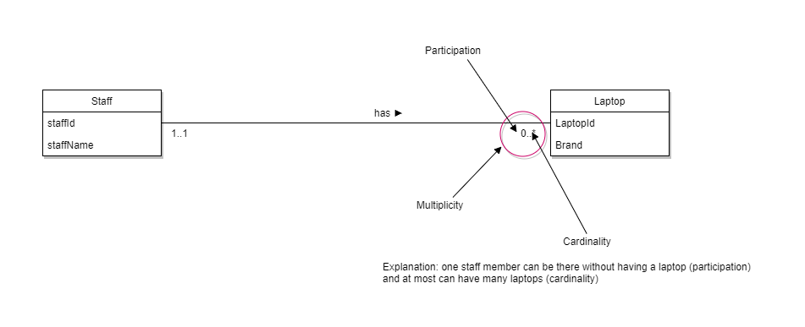
Multiplicity and Cardinality
Multiplicity = Cardinality + Participation
https://martinfowler.com/bliki/Multiplicity
NotCardinality.html

Slide 4
Alternative names
Official terms | Alternative option 1 | Alternative option 2
Relation​​ | Table​​ | File ( file )
Tuple​​ | Row​ | Record​
Attribute ( attribute ) | Column​​​ | Field​

Slide 5
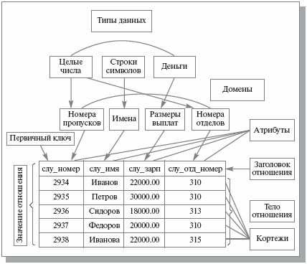
Relational Table: What is What

Slide 6
Properties of a relational table
A table is a two-dimensional structure consisting of rows and columns.
Each row of the table (tuple) represents a separate entity within a set of entities
Each column of the table represents an attribute, and each column has its own name.
At each intersection of a row and a column there is a unique value
Each table must have an attribute or multiple attributes that uniquely identify each row.
All values in a column must be displayed in the same format. For example, if an attribute is assigned an integer format, then all values in the column representing that attribute must be integers.
Each column has a specific range of values, called the domain of the attribute.
The order of rows and columns is not significant.

Slide 7
Relational Database Keys
Key type | Definition
Superkey​​ | An attribute (or combination of attributes) that uniquely identifies each entity in a table
Candidate key | Minimal superkey: A superkey that does not contain a subset of attributes that is itself a superkey.
Primary key | A candidate key chosen to uniquely identify all other attribute values in any row. Cannot contain null values.
Secondary key​ | An attribute (or combination of attributes) used solely for data retrieval purposes.
Foreign key | An attribute (or combination of attributes) in one table whose values must either match the primary key values of another table or be empty.

Slide 8
Keys example
Human
id | inn | surname | Name | surname | passport series | passport number | date of birth
Super key | Potential key | Primary key | foreign key | secondary
id | id | id | id | f+i+o+ date of birth
inn | inn
full name + i + o + date of birth | full name + i + o + date of birth
passport series + passport number | passport series + passport number
f+i+o+INN
f+inn
…
id+INN+ f+i+o+series+number+date of birth

Slide 9
Keys

Slide 10
Data integrity
Empty value. Indicates that the attribute value is currently unknown or unacceptable for this tuple.
Data integrity
At the essence level
At the link level
By action
Cascading
Set empty value/ default value
Limitation
Declarative
At the link level By mechanism
Active

Slide 11
Referential integrity
Name of the save type | SQL code | What happens when you delete | What happens when you update
Limitation | restrict | Prevents deleting data from a parent table if it is linked to any data in a child table (check immediately) | Prevents changing the primary key from the parent table if any data in the child table is associated with it (check immediately)
Limitation | No action | Prevents deleting data from a parent table if it has any data associated with it in a child table (check deferred) | Prevents changing the primary key from a parent table if any data in the child table is associated with it (check deferred)
Cascading | cascade | When you delete data from a parent table, the associated data in the child table will be deleted. | When you change the primary key in a parent table, the foreign keys associated with it in the child table will change to the same value.
Installation | set null | When deleting data from a parent table, the foreign keys of the child table associated with the deleted data will receive an empty value ( null ) | When changing the primary key of the parent table, the foreign keys of the child table associated with the changed keys will receive an empty value ( null )
Installation | set default | When deleting data from a parent table, the child table's foreign keys associated with the deleted data will receive a default value that must be set in the child table. | When changing the primary key of the parent table, the foreign keys of the child table associated with the changed keys will receive the default value that must be set in the child table.

Slide 12
Relational algebra
Relational algebra is a collection of operations that take relations as operands and return a relation as a result.

Slide 13
Operations of relational algebra
Traditional set operations (booleans/ set-theoretic)
union : A UNION B, A ∪ B;
intersection : A INTERSECT B, A ∩ B;
difference : A MINUS B,AB;
Cartesian product A TIMES B ;A × B
Special relational operations
reduction ( selection) A WHERE p ;
projection;
connection ; A JOIN B ; A⋈B​​
Division ; A ÷ B .
Renaming an attribute

Slide 14



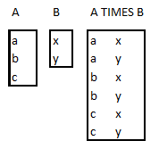
Booleans / set-theoretic operations
union : A UNION B, A ∪ B;
intersection : A INTERSECT B, A ∩ B;
difference : A MINUS B,AB;
Cartesian product A TIMES B ;A × B

Slide 15
Unification
Given relations a and b of the same type, the union of these relations a UNION b is a relation of the same type with body consisting of all tuples t present in a or b, or in both relations.
a ∪ b= { t: t∊a ⋁ t∊b }

Slide 16
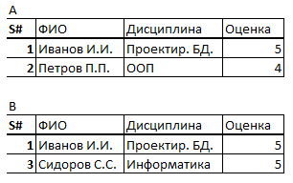
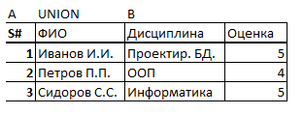
Union example

Slide 17
Union. Properties
Commutativity a ∪ b= b ∪ a
A binary operator g is called commutative if g(a,b) = g(b,a) for any a and b
Associativity a ∪ ( b ∪c ) = (a ∪ b) ∪c
A two-place operator g is called associative if g(a,g(b,c)) =g(g(a,b),c) for any a, b, c.

Slide 18
Intersection
If relations a and b are of the same type, then the intersection of these relations a INTERSECT b is a relation of the same type with body consisting of all tuples t such that t is present simultaneously in a and b.
a∩b= { t: t∊a, t∊b }

Slide 19

Intersection example

Slide 20
Intersection. Properties
Commutativity a ∩ b= b ∩ a
A binary operator g is called commutative if g(a,b) = g(b,a) for any a and b
Associativity a ∩ ( b ∩ c ) = (a ∩ b) ∩ c
A two-place operator g is called associative if g(a,g(b,c)) =g(g(a,b),c) for any a, b, c.

Slide 21
Difference
If relations a and b are of the same type, then the difference of these relations, a MINUS b (in that order), is a relation of the same type with body consisting of all tuples t such that t is present in a but not in b.
a - b= { t: t∊a, : t∉b }

Slide 22
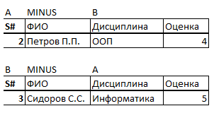
Difference. Example

Slide 23
Cartesian product
the Cartesian product a TIMES b of relations a and b that have no common attributes, as a relation whose head is the (set-theoretic) union of the heads of relations a and b, and whose body consists of all tuples t such that t is the (set-theoretic) union of a tuple belonging to relation a and a tuple belonging to relation b.
a × b={t:t=(t1,t2) t1∊a, t2∊b }

Slide 24

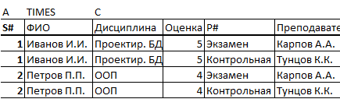
Cartesian product example

Slide 25
Special relational operations
reduction ( sample)
projection;
connection :
Natural connection
Theta connection
Equijunction
Division ; A ÷ B .
Renaming an attribute

Slide 26
Selection (reduction)
The select operation is applied to a single relation R and determines a resulting relation that contains only those tuples (rows) from the relation R that satisfy a given condition (predicate).
Sigma
σ _{X=x} (a)= {t: t∊a, t(X)=x}

Slide 27
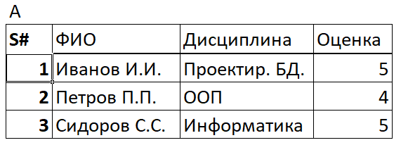
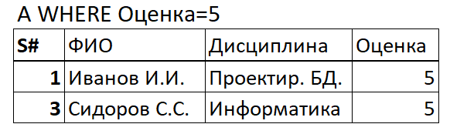
Sample example

Slide 28
Sample properties
The sample is distributive with respect to intersection, union, and difference
A one-place operator f is called distributive with respect to a two-place operator g if f(g(a,b)) = g(f(a),f(b)) for any a and b .
The sample is distributive with respect to the join provided that the selection condition is no more complex than the conjunction (AND) of two different conditions, one for each of the two operands .

Slide 29
Projection
The projection operation is applied to a relation R and defines a new relation containing a vertical subset of the relation R , created by extracting the values of the specified attributes and excluding duplicate rows from the result
π _{x} ( a )={ t ( x ), : t ∊ a }

Slide 30
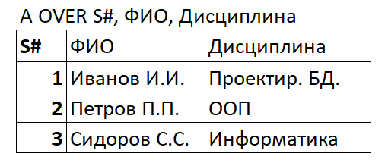
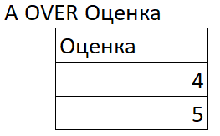
Projection example

Slide 31
Projection properties
No attribute may appear in the comma-separated list of attribute names more than once.
The projection is distributive with respect to the union
Single operator f is called distributive with respect to a binary operator g if f ( g ( a,b )) = g ( f ( a ), f ( b )) for any a and b .
A projection is distributive with respect to a join provided that all attributes on which the join is performed are included in the projection.

Slide 32
Compound
Natural connection A JOIN B, A ⋈ B
Theta connection ( A TIMES B ) WHERE X θ U , A ⋈ _{F} B
Equijunction ( A TIMES B ) WHERE X = U , A ⋈ _{F} B

Slide 33
Theta connection
R ⋈ _{F} S . The theta join operation defines a relation that contains the tuples from the Cartesian product of relations R and S that satisfy a predicate F. The predicate F has the form Ra _{i} θ S .b _{i} , where instead of θ one can be specified from comparison operations (<, ≤ , >, ≥ ,= , ≠ ).

Slide 34
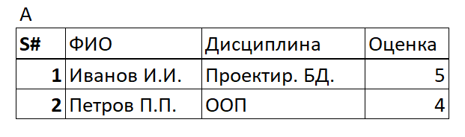
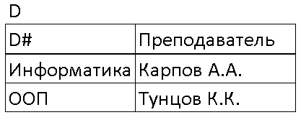
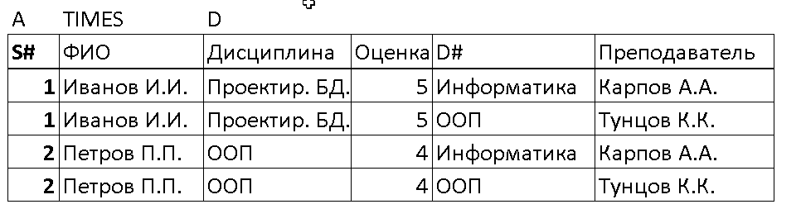
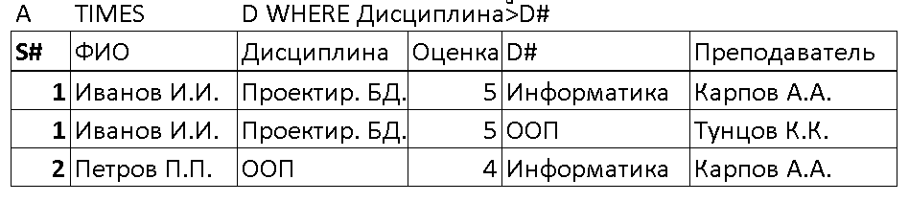
Theta connection
A ⋈ _{Discipline >D#} D

Slide 35
Equijunction
R ⋈ _{F} S Defines a relation that contains tuples from Cartesian products of relations R and S that satisfy the predicate F (the predicate must provide only for equality comparison)

Slide 36

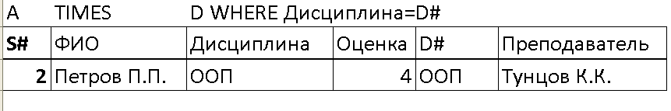
Equijunction example
A ⋈ _{Discipline= D#} D

Slide 37
Natural connection
R ⋈ S. A natural conjunction is a conjunction by equivalence.
two relations R and S, performed on all common attributes x, from the results of which one instance of each common attribute is excluded.

Slide 38
Natural connection
Let us assume that the relations a and b are respectively obviously have the following attributes: X 1 , X 2 , . . . , X m , Y 1 , Y 2 , . . . , Yn
Yl , Y2, . . . , In , Z l , Z 2 , . . . , Zp
THIS means that the two relations under consideration have a common set of attributes Y, consisting of attributes Yl , Y2, . . ., Yn (and only of these attributes), other attributes of relation a form a set x , consisting of attributes X1 , X2, Xm , and other attributes of relation b form a set z , consisting of attributes Z1, Z2, . . ., Zp .
In this case, the ( natural ) connection of a and b is expressed as follows.
a JOIN b
It is a relation with a header { X, Y, Z } and a body consisting of all such tuples { X x , Y y, z z } such that any of these tuples is present both in relation a, with value x of attribute x and value y of attribute Y, and in relation b , with value y of attribute Y and value z of attribute Z.

Slide 39

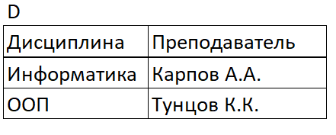
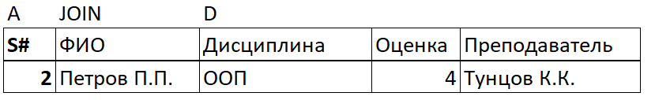
Natural connection example
A ⋈ D

Slide 40
Division
Suppose that relation R is defined on a set of attributes A, and relation S is defined on a set of attributes B, where B ⊆ A (i.e. B is a subset of A). Let C=A-B, i.e. C is the set of attributes of relation R that are not attributes of relation S. Then the definition of the division operation will look like this.
R ÷ S, The result of the division operation is a set of tuples of relation R, defined on a set of attributes C , which correspond to the combination of all tuples of relation S.
R DIVIDE BY S PER C

Slide 41
Division example
dividend (DEND), divisor ( DOR ), mediator (MED)
DEND ⋈ MED ÷ DOR

Slide 42
Additional operators of relational algebra
Attribute renaming operator S RENAME CITY AS SCITY
A RENAME Atr ₁ , Atr ₂ AS NewAtr ₁ , NewAtr ₂ where Atr ₁ , Atr ₂ are old attribute values NewAtr ₁ , NewAtr ₂ are new attribute values
Assignment operator Result ← operation
Attribute renaming operator

Slide 43
Rename operator
ρ _{s} (E) or
The renaming operation allows you to assign a new name S to expression E, and also additionally rename attributes as a ₁ , a ₂ ,… a _{n}

Slide 44
Priorities of Relational Algebra Operations
Operation | Priority
Renaming | 4
Sample | 3
Projection | 3
Cartesian product | 2
Compound | 2
Intersection | 2
Division | 2
Unification | 1
Difference | 1

Slide 45
RelaX relational algebra calculator
http://clotho.uom.gr/relax/help.htm
https://dbis-uibk.github.io/relax/calc/local/uibk/local/0

Slide 46

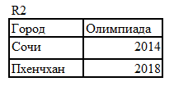
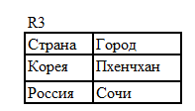




Examples of problem solving 1
Find countries whose athletes participated in the Pyeongchang Olympics
Answer

Slide 47




Examples of problem solving 2
Find the countries that participated in the Olympics in Korea and won 1st place
Answer

Slide 48

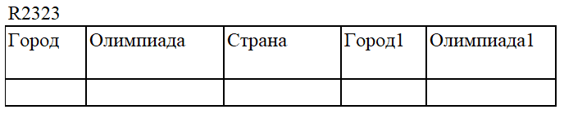
Examples of problem solving 3
Find a country that hosted more than 1 olympiad
Answer

Slide 49
Examples of problem solving 4
Find a country that has hosted NO more than 1 Olympics
Answer

Slide 50
Examples of solving problems 5
Find countries whose athletes did not participate in the Olympics in Pyeongchang
Answer

Slide 51
Examples of solving problems 6
Find countries whose athletes have participated in all Olympics
Answer

Slide 52
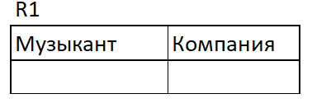
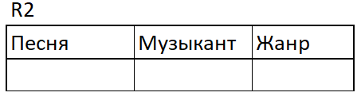
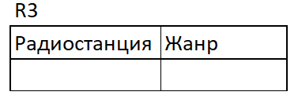

Tasks for independent solution
Find a musician whose songs were played on all radio stations
Find companies whose artists' songs were played on the radio station "Europa Plus"
Find songs that were played on the same radio station more than once
Find genres typical for radio stations where the group "Uma Thurman" performs
Find songs that were played on the same radio station only once

